Slide 1
Control

Slide 2
Outline
Translate loops in C to assembly
Conditional Move
Translate switch in C to assembly
Suggested reading
  Chap 3.6.5, 3.6.6, 3.6.7

Slide 3
Do-while Translation
do
body-statement
while (test-expr)
loop:
body-statement
t = test-expr;
if ( t )
goto loop ;

Slide 4
Do-while Translation
.L6:
lea (%ebx, %edx), %eax
movl %edx, %ebx
movl %eax, %edx
incl %ecx
cmpl %esi, %ecx
jl .L6
movl %ebx, %eax
int fib_dw(int n)
{
int i = 0;
int val = 0 ;
int nval = 1 ;
do {
int t = val + nval ;
val = nval ;
nval = t ;
i++;
} while ( i<n) ;
return val ;
}
register | value | initially
%ecx | i | 0
%esi | n | n
%ebx | val | 0
%edx | nval | 1
%eax | t | -

Slide 5
While Loop Translation
while (test-expr)
body-statement
loop: if ( !test-expr)
t = test-expr goto done;
if ( !t ) do
goto done; body-statement
body-statement while(test-expr)
goto loop; done:
done:

Slide 6
While Loop Translation
int fib_w_goto(int n)
{
int val=1;
int nval=1;
int nmi, t ;
if ( val >= n )
goto done ;
nmi = n-1;
loop:
t=val+nval ;
val = nval ;
nval = t ;
nmi--;
if ( nmi )
goto loop
done:
return val
}
int fib_w(int n)
{
int i=1;
int val=1;
int nval=1;
while ( i<n ) {
int t=val+nval ;
val = nval ;
nval = t ;
i++;
}
return val ;
}

Slide 7
While Loop Translation
Register usage
movl 8(%ebp), %eax
movl $1, %ebx
movl $1, %ecx
cmpl %eax, ebx
jge .L9
lea –1(%eax), %edx
.L10:
lea (%ecx, %ebx), %eax
movl %ecx, %ebx
movl %eax, %ecx
decl %edx
jnz .L10
.L9:
Register
Variable
Initially
%edx
nmi
n-1
%ebx
val
1
%ecx
nval
1

Slide 8
For Loop Translation
for ( init-expr; test-expr; update-expr)
body-statement
init-expr
while ( test-expr) {
body-statement
update-expr
}

Slide 9
Conditional Move
Original C code
1 int absdiff(int x, int y) {
2 return x < y ? y-x : x-y;
3 }
(b) Implementation using conditional assignment
1 int cmovdiff(int x, int y) {
2 int tval = y-x;
3 int rval = x-y;
4 int test = x < y;
5 /* Line below requires
6 single instruction: */
7 if (test) rval = tval;
8 return rval;
9 }

Slide 10
Conditional Move
(c) Generated assembly code
(x at %ebp+8, y at %ebp+12)
movl 8(%ebp), %ecx Get x
movl 12(%ebp), %edx Get y
movl %edx, %ebx Copy y
subl %ecx, %ebx Compute y-x
movl %ecx, %eax Copy x
subl %edx, %eax Compute x-y and set as return value
cmpl %edx, %ecx Compare x:y
cmovl %ebx, %eax If < , replace return value with y-x
%ecx x
%edx y
%ebx y-x
%eax x-y

Slide 11
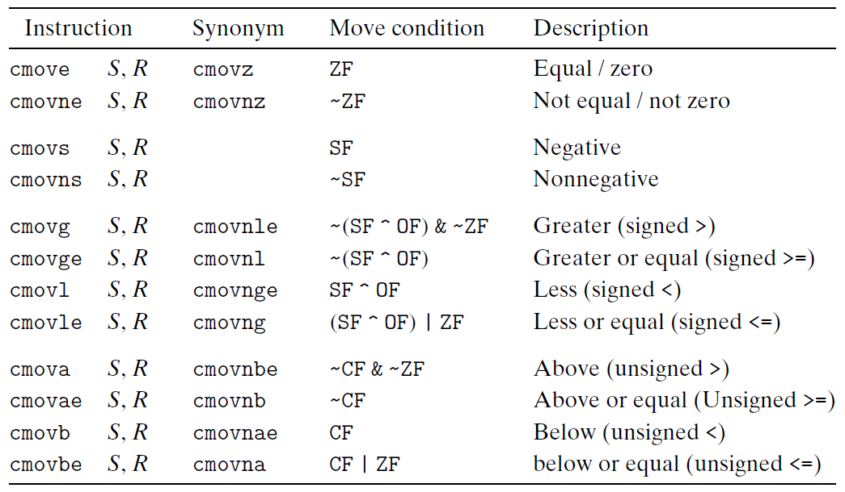
Conditional Move
Properties of Switch Construct
  Integer testing
  Multiple outcomes (may be a large number)
  Improve the readability of the source code

Slide 12
Invalid Situation
Conditional Move instructions suppose that “there is no side effect”
  int cread(int *xp) {
  return (xp ? *xp : 0);
  }

Slide 13
Conditional Move
Original C code
1 int absdiff(int x, int y) {
2 return x < y ? y-x : x-y;
3 }
(b) Implementation using conditional assignment
1 int cmovdiff(int x, int y) {
2 int tval = y-x;
3 int rval = x-y;
4 int test = x < y;
5 /* Line below requires
6 single instruction: */
7 if (test) rval = tval;
8 return rval;
9 }

Slide 14
Conditional Move
(c) Generated assembly code
(x at %ebp+8, y at %ebp+12)
movl 8(%ebp), %ecx Get x
movl 12(%ebp), %edx Get y
movl %edx, %ebx Copy y
subl %ecx, %ebx Compute y-x
movl %ecx, %eax Copy x
subl %edx, %eax Compute x-y and set as return value
cmpl %edx, %ecx Compare x:y
cmovl %ebx, %eax If < , replace return value with y-x
%ecx x
%edx y
%ebx y-x
%eax x-y

Slide 15
Conditional Move
Properties of Switch Construct
  Integer testing
  Multiple outcomes (may be a large number)
  Improve the readability of the source code

Slide 16
Invalid Situation
Conditional Move instructions suppose that “there is no side effect”
  int cread(int *xp) {
  return (xp ? *xp : 0);
  }

Slide 17
Switch Construct
Properties of Switch Construct
  Integer testing
  Multiple outcomes (may be a large number)
  Improve the readability of the source code

Slide 18
Switch Statements
int switch_eg(int x, int n)
{
int result = x ;
switch ( n ) {
case 100:
result *= 13 ;
break ;
case 102:
result += 10 ;
/* fall through */
case 103
result += 11;
break ;
case 104: case 106:
result *= result ;
break ;
default:
result = 0 ;
}
return result ;
}
Multiple cases
Integer testing

Slide 19
Switch Form
switch(op) {
case val_0:
Block 0
case val_1:
Block 1
• • •
case val_n-1:
Block n–1
}

Slide 20
Jump Table
Efficient implementation
Avoid long sequence of if-else statement
Criteria
  the number of cases and the sparcity of the case value

Slide 21
From Cases to Targets
switch(op) {
case val_0:
Block 0
case val_1:
Block 1
• • •
case val_n-1:
Block n–1
}
Targ0:
Code Block 0
Targ1:
Code Block 1
Targ2:
Code Block 2
•
•
•
Targn-1:
Code Block n–1

Slide 22
Construct a Jump Table
Jump Table
Jump Targets
jtab:
Targ0
val_0
Targ0:
Code Block 0
.
.
Targ1
val_1
Targ1:
Code Block 1
.
.
Targ2
val_2
Targ2:
Code Block 2
•
•
•
•
•
•
Targn-1
val_n-1
Targn-1:
Code Block n–1

Slide 23
Implement the Switch
Approx. Translation
Jump Targets
target = JTab[op];
goto *target;
Targ0:
Code Block 0
Jump Table
Targ1:
Code Block 1
jtab:
Targ0
val_0
Targ2:
Code Block 2
………
Targ1
val_1
………
•
•
•
Targ2
val_2
•
•
•
Targn-1:
Code Block n–1
Targn-1
val_n-1

Slide 24
Switch Statements
int switch_eg(int x, int n)
{
int result = x ;
switch ( n ) {
case 100:
result *= 13 ;
break ;
case 102:
result += 10 ;
/* fall through */
case 103
result += 11;
break ;
case 104: case 106:
result *= result ;
break ;
default:
result = 0 ;
}
return result ;
}

Slide 25
Jump Table Implementation
code jt[7] = {loc_a, loc_def, loc_b, loc_c, loc_d, loc_def, loc_d};
int switch_eg_goto ( int x, int n)
{
unsigned ni = n - 100;
int result = x ;
if ( ni >6 )
goto loc_def ; //default
goto jt[xi];
loc_a: //100
result *= 13 ;
goto done ;
loc_b: //102
result += 10 ; /* fall through*/
loc_c: //103
result +=11;
goto done ;
loc_d: //104, 106
result *= result ;
goto done ;
loc_def: //default
result = 0 ;
done:
return result ;
}

Slide 26
Code Layout
0xffffffff
memory invisible to
user code
kernel virtual memory
0xc0000000
Linux/x86
process
memory
image
Read/write data
Read only data
Read only code
%eip
0x08048000
forbidden

Slide 27
Jump Table
.section .rodata
.align 4
.L7:
.long .L3 case 100: loc_a
.long .L2 case 101: loc_def
.long .L4 case 102: loc_b
.long .L5 case 103: loc_c
.long .L6 case 104: loc_d
.long .L2 case 105: loc_def
.long .L6 case 106: loc_d

Slide 28
Jump Table Implementation
movl 8(%ebp), %edx get x
movl 12(%ebp), %eax get n
subl $100, %eax compute index = n – 100
cmpl $6, %eax compare index:6
ja .L2 If > , goto default
jmp *.L7(, %eax, 4)
.L2: default:
mov $0, %eax result = 0
jmp .L8 goto done

Slide 29
Jump Table Implementation
.L5: loc_c: // 103
movl %edx, %eax result = x
jmp .L9 goto rest
.L3: loc_a: // 100
leal (%edx, %edx, 2), %eax result = x * 3
leal (%edx, %eax, 4), %eax result = x + 4 * result
jmp .L8 goto done
.L4: loc_b: // 102
leal 10(%edx), %eax result = x + 10

Slide 30
Jump Table Implementation
.L9: rest: // fall through
addl $11, %eax result += 11
jmp .L8 goto done
.L6: loc_d: // 104, 106
movl %edx, %eax result = x
imull %edx, %eax result *= x
.L8: done:

